Slide 1
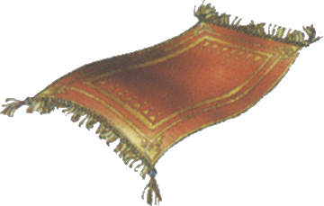
How could you find out how much carpet is used in this room?
Think
Pair
Share
Notes:
Think pair share activity

Slide 2
24
7
30
Date
Area of Rectangles
EQ – How can we calculate the area of a rectangle?
What is Area?
Area is the space inside a shape
Counting squares
The number of squares inside the rectangle is the area
2 3 4 5 6 7
9 10 11 12 13 14
15 16 17 18 19 20 21
Number of squares
=21
Area= 21 square units
5

Slide 3

Find the area of the following.
6 square units
17 square units
I was just testing you
It’s 13 square units

Slide 4
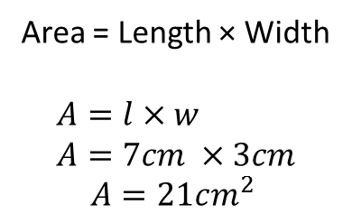
24
7
30
Area of Rectangles
EQ – How can we calculate the area of a rectangle?
Length = 7 cm
Width = 3 cm
Squares across
Squares top to bottom
Area formula
Area = Length × Width
$$A=l×w \\ A=7cm ×3cm$$
$$A=21cm^{2}$$

Slide 5
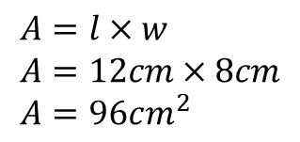
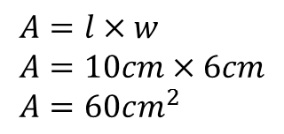
10cm
$$A=l×w \\ A=10cm×6cm \\ A=60cm^{2}$$
6cm
$$A=l×w \\ A=12cm×8cm \\ A=96cm^{2}$$
8cm
12cm

Slide 6
Practice
Complete exercise 2.1 and 2.2
Page 18-19

Slide 7
10 quick Questions
Notes:
If you need to program see Adam before your lesson. It is on the share drive.

